Slide 1
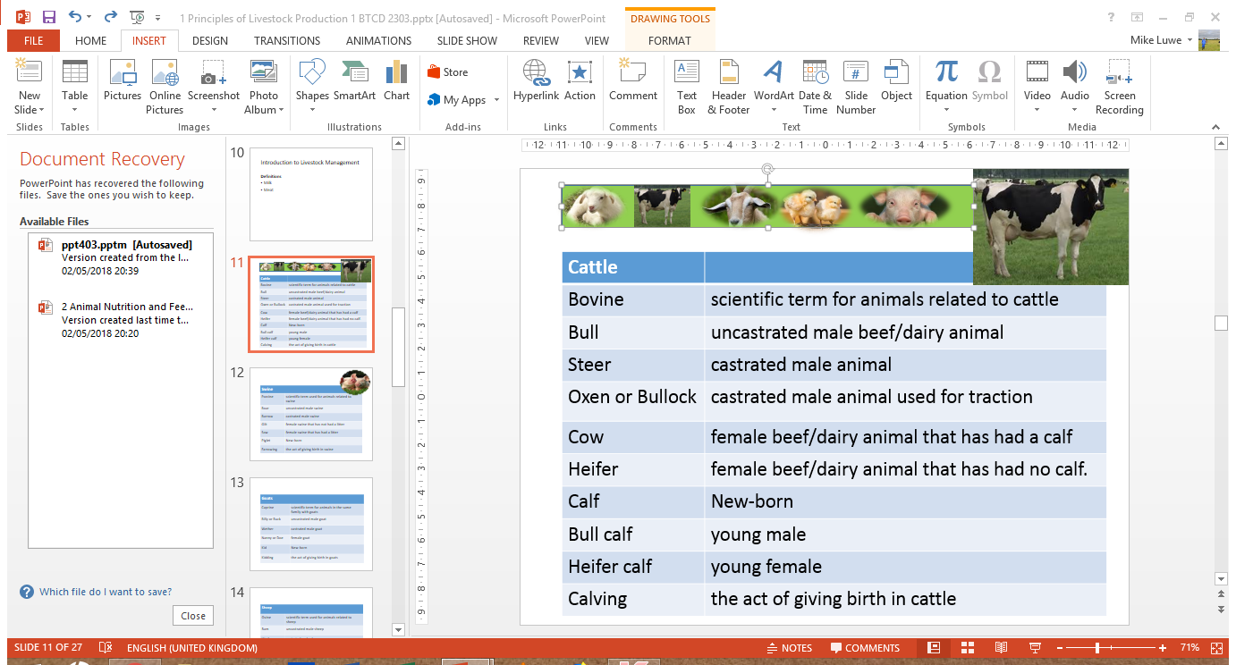
Animal Nutrition and Feed Formulation Technology
Michael Luwe
Veterinarian
Department of Animal Health and Livestock Development

Slide 2
Animal Nutrition and Feed Formulation Technology
Definitions
Nutrition is the science that interprets the interaction of nutrients and other substances in food that influence the maintenance, growth, development, reproduction, and health of animals.
Digestion denotes the process of breaking feed down into simple substances that can be absorbed by the body.
Absorption refers to taking the digested parts of the feed into the bloodstream.
Food/feed is material that, after ingestion by animals, is capable of being digested, absorbed and utilised.
Notes:
In a more general sense we use the term ‘food’ to describe edible material.
Grass and hay, for example, are described as foods, but not all their components are
digestible.

Slide 3
Animal Nutrition and Feed Formulation Technology
Definitions
Nutrients are components capable of being utilised by animals.
Feedstuff is any material used for feed.
An ingredient in feed is a component or constituent that comprises the feed. Thus, feedstuff and feed ingredient are interchangeable terms.
Enzymes are substances called organic catalysts that speed up the digestive process.

Slide 4
Animal Nutrition
Animals can be classified into 3 groups based on what they eat:
Herbivores – which eat plant
Omnivores – they eat both plants and meat
Carnivores - which eat chiefly meat
The diet of farm animals in particular consists of plants and plant products, although some foods of animal origin such as fishmeal and milk are used in limited amounts.
Animals differ in the kinds and amounts of nutrients they need.
Nutrients are divided into five groups:
(1) energy nutrients (carbohydrates, fats, and oils),
(2) proteins,
(3) vitamins,
(4) minerals, and
(5) water.
Plants and animals contain similar types of chemical substances, and we can group these into classes according to constitution, properties and function.

Slide 5
The main components of foods (plants and animals) are:

Slide 6
ANALYSIS AND CHARACTERISATION OF FOOD
Proximate analysis of foods is a system of analysis of the composition of foods.
More recently, new analytical techniques have been introduced, and the information about food composition is rapidly expanding.
This system of analysis divides the food into six fractions: moisture, ash, crude protein, ether extract, crude fibre and nitrogen-free extractives.
composition of foods was based on a system of analysis described as the proximate analysis of foods, which was devised over 100 years ago by two German scientists, Henneberg and Stohmann. More recently, new analytical techniques have been introduced, and the information about food composition is rapidly expanding (see below).

Slide 7
Water
It is the largest constituent of animal.
Water functions in the body as a solvent in which nutrients are transported about the body, a vehicle for evaporative cooling and as a solvent in which waste products are excreted.
The animal obtains its water from three sources:
drinking water,
water present in its food, and
metabolic water.
Water losses occur through sweat, urine, faecal matter, and vapour
Notes:
The newborn animal contains 750–800 g/kg water but this falls to about 500 g/kg in the mature fat animal. It is vital to the life of the organism that the water content of the body be maintained: an animal will die more rapidly if deprived of water than if deprived of food.
metabolic water, this last being formed during metabolism by the oxidation of hydrogen-containing organic nutrients.
Metabolic water is formed during metabolism by the oxidation of hydrogen-containing organic nutrients

Slide 8
Dry Matter
The dry matter (DM) of foods is conveniently divided into organic and inorganic material.
Plants store energy largely in the form of carbohydrates such as starch and fructans, whereas an animal’s main energy store is in the form of lipid.
In both plants and animals, proteins are the major nitrogen-containing compounds.
The inorganic matter contains all those elements present in plants and animals other than carbon, hydrogen, oxygen and nitrogen.
Calcium and phosphorus are the major inorganic components of animals, whereas potassium and silicon are the main inorganic elements in plants.
Notes:
The dry matter (DM) of foods is conveniently divided into organic and inorganic material, although in living organisms there is no such sharp distinction. Many organic compounds contain mineral elements as structural components.

Slide 9
Carbohydrates
The main energy nutrients found in animal rations are carbohydrates. They are made up of sugars, starches, cellulose, and lignin.
Carbohydrates are chemically composed of carbon, hydrogen, and oxygen.
Monosaccharides and disaccharides are highly soluble.
Starch is the most important non-fibrous polysaccharide in plants and comes in two types: amylose and amylopectin.

Slide 10
Carbohydrates
Cellulose and hemicellulose are fibrous polysaccharides and are insoluble and difficult to digest.
Lignin is indigestible and its concentration is higher in stems than leaves.
Simple carbohydrates (starch and sugars) are referred to as nitrogen-free extract (NFE) and come from the cereal grains, such as maize, wheat, oats, barley, rye, and sorghum.

Slide 11
Carbohydrates
The complex carbohydrates, called fiber, are cellulose and lignin. These substances are more difficult to digest than simple carbohydrates. Fiber is found mainly in roughages such as hay and pasture plants.
The carbohydrate of the food is contained in two fractions, the crude fibre (CF) and the nitrogen-free extractives (NFE).The former is determined by subjecting the residual food from ether extraction to successive treatments with boiling acid and alkali of defined concentration; the organic residue is the crude fibre.

Slide 12
Fats/Lipids
Fats and oils are also energy nutrients. They are chemically composed of carbon, hydrogen, and oxygen. In animal nutrition, both fats and oils are commonly referred to as fats.
Fats are easily digested by animals. They provide energy and improves palatability. They also carry the fat-soluble vitamins that are in the feed.
Lipids can be classified as simple – esters of fatty acids with various alcohols; compound – esters of fatty acids with alcohol and other groups e.g. lipoprotein, and sterols – lipids with complex phenanthrene ring structures e.g. cholesterol

Slide 13
Fats/Lipids
Commonest fatty acids in plant and animal tissues are butyric, palmitic, myristic, oleic, linoleic, arachidonic, lauric, capric and stearic acids.
Essential fatty acids – fatty acids that the body cannot synthesize but are required by animals e.g. linoleic, oleic and arachidonic acids.
The ether extract (EE) fraction is determined by subjecting the food to a continuous extraction with petroleum ether for a defined period. The residue, after evaporation of the solvent, is the ether extract.

Slide 14
Proteins
Proteins are organic compounds made up of amino acids. Amino acids contain carbon, hydrogen, oxygen, and nitrogen. Some amino acids also contain sulphur, phosphorus, and iron.
Proteins supply material to build body tissues and also play a role in metabolic functions.
Plants can synthesize all amino acids from inorganic nitrogen sources such as ammonia.
The liver is the principal site of amino acid synthesis in animals.
Amino acids differ in terms of their essentiality in animal’s tissue.
Essential amino acid is an amino acid that is needed by an animal but cannot be synthesized by the body.

Slide 15
Proteins
Non-essential amino is an amino acid needed by the animal but can be partly or completely synthesized by the animal’s tissue from other amino acids.
Limiting amino acid is an amino acid which is present in a protein in the least amount in relation to the animal’s needs for that particular amino acid.
If an animal takes in more protein than it needs, the nitrogen is separated and given off in the urine. The material that is left is converted into energy or body fat by the animal.
Ten amino acids are considered to be essential for swine, and 14 are essential for poultry.
Essential amino acids include Arginine (Arg), Histidine (His), Leucine (Leu), Isoleucine (Iso), Lysine (Lys), Methionine (Met), Threonine (Thr), Phenylalanine (Phe), Tryptophan (Trp) and Valine (Val)

Slide 16
Proteins
Non-essential amino acids are needed by animals, but are synthesized in the body from other amino acids.
Monogastric animals cannot synthesize the essential amino acids fast enough to meet their needs; therefore, those amino acids must be provided in their rations.
Ruminants can generally synthesize the essential amino acids by rumen bacterial action at a rate sufficient to meet their needs.
Animal protein sources are considered to be good-quality proteins since they usually contain a good balance of the essential amino acids.

Slide 17
Proteins
The amino acid needs of ruminants can be met by feeding proteins from vegetable sources. They can also be met by including urea in the ration.
The amount of crude protein (total protein) is the amount of ammoniacal nitrogen in the feed multiplied by 6.25.
Not all of the crude protein in a feed is digestible. Digestible protein is approximately the amount of true protein in a feed.
The crude protein (CP) content is calculated from the nitrogen content of the food, determined by a modification of a technique originally devised by Kjeldahl over 100 years ago.
Notes:
It is assumed that the nitrogen is derived from
protein containing 16 per cent nitrogen, and by multiplying the nitrogen figure by 6.25
(i.e. 100/16) an approximate protein value is obtained

Slide 18
Minerals
Minerals are inorganic materials needed in various amounts by animals. Minerals contain no carbon. Thus, if a feed were completely burned, the ash that was left would be the mineral content of the feed.
They provide material for the growth of bones, teeth, and tissue.
Minerals also regulate many of the vital chemical processes of the body.
They aid in muscular activities, reproduction, digestion of feed, repair of body tissues, formation of new tissue, and release of energy for body heat.

Slide 19
Minerals
Minerals are divided into two groups. Major minerals are those needed in large amounts. Trace minerals are those needed in small amounts.
Major minerals that are often lacking in animal rations are salt (sodium and chlorine), calcium, and phosphorus. It is important to make sure that these minerals are included in the animal’s ration. The ratio of calcium to phosphorus in swine rations should not be greater than 1.5 to 1. The ratio of calcium to phosphorus for ruminants can be as high as 7 to 1.
Trace minerals that are necessary for animals include potassium, sulphur, magnesium, iron, iodine, copper, cobalt, zinc, manganese, boron, molybdenum, fluorine, and selenium. Most of these trace minerals are found in common animal feeds.

Slide 20
Vitamins
They are trace organic compounds. In other words, they are needed only in very small amounts by animals. All vitamins contain carbon, but they are not like chemically.
Vitamins are divided into two groups: fat-soluble and water-soluble.
The fat-soluble vitamins are A, D, E, and K. Vitamin A is associated with healthy eyes, good conception rate, and disease resistance. Vitamin D is associated with good bone development and the mineral balance of the blood.
Vitamin E is necessary for normal reproduction and muscle development.
Notes:
Fat-soluble vitamins can be dissolved in fat. Water-soluble vitamins can be dissolved in water.

Slide 21
Vitamins
Recent research suggests that increasing the level of vitamin E alone or in combination with selenium in the diet may help strengthen the immune system of several animal species.
Vitamin K helps the blood to clot and prevents excessive bleeding from injuries.
Some sources of the fat-soluble vitamins are green leafy hay, yellow maize, fish oils, wheat germ oil, and green pastures. Vitamin D is produced in the animal’s body if the animal is in direct sunlight part of the day.
Notes:
Fat-soluble vitamins can be dissolved in fat. Water-soluble vitamins can be dissolved in water.

Slide 22
Vitamins
The water-soluble vitamins include vitamin C and the B-complex vitamins.
The B-complex includes many different vitamins. These are: B1 (thiamine), riboflavin, niacin, pyridoxine, pantothenic acid, biotin, folic acid, benzoic acid, choline, and vitamin B12.
Vitamin C helps in teeth and bone formation and the prevention of infections.
The B-complex vitamins are necessary for chemical reactions in the animal’s body. They help improve appetite, growth, and reproduction.
Some sources of vitamin C are green pastures and hay. Some sources of the B-complex vitamins are green pastures, cereal grains, green leafy hay, milk, fish solubles, and certain animal proteins.
Notes:
Fat-soluble vitamins can be dissolved in fat. Water-soluble vitamins can be dissolved in water.

Slide 23
FEEDS CLASSIFICATION
Roughages
They have more than 18% Crude Fibre.
Succulents - pasture, grazed plants
Dry roughages – hay (grass, straw, legume), maize cobs, cotton hulls
Energy Feeds
Have less than 18% CF and less than 20% CP
Examples include cereal grains, bran, molasses, roots
Protein feeds/Supplements
They have more than 20% CP e.g. methionine
They can originate from animal and plants
Notes:
Fat-soluble vitamins can be dissolved in fat. Water-soluble vitamins can be dissolved in water.

Slide 24
Feeds Classification
Mineral Supplement
They provide different types of minerals e.g. Calcium carbonate, Limestone, Ferrous sulphate
Vitamin Supplements
Provide vitamins e.g. Biotin, Niacin, riboflavin
Non-nutritive Additives
These include antibiotics, antioxidants, coccidiostats, enzymes and hormones.
Notes:
Fat-soluble vitamins can be dissolved in fat. Water-soluble vitamins can be dissolved in water.

